Slide 1
Programming Microcontroller
Assembly and C
Course Number : TTH2D3
CLO : 2
Week : 5-7
CLO#2 Student have the knowledge to create basic programming for microcontroller
[C3] Understand how to program in Assembly
[C3] Understand how to program a microcontroller using C
[C3] Understand how to store the program in microcontroller

Slide 2
What is the difference between μP, μC, and Development Board?
development board
microcontroller
External Memory
Pin Connector
microprocessor
memory
CU
Register
Flash
SRAM
EEPROM
ALU
Programmable
Input / Output
Power
Regulator
Programmable
Timer / Counter
Programmable
Interrupt Controller
(Crystal) Clock
Regulator

Slide 3
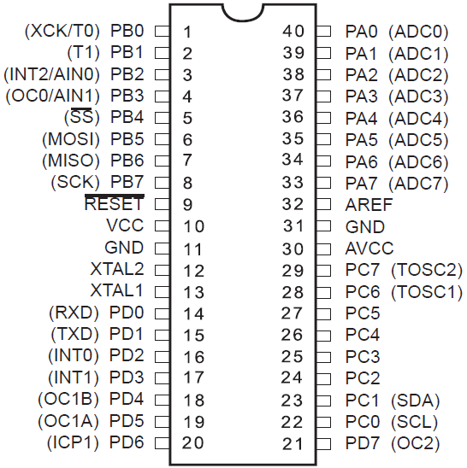
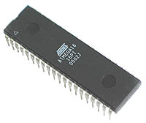
MICROCONTROLLER (μC) AVR ATMEGA 8535

Slide 4
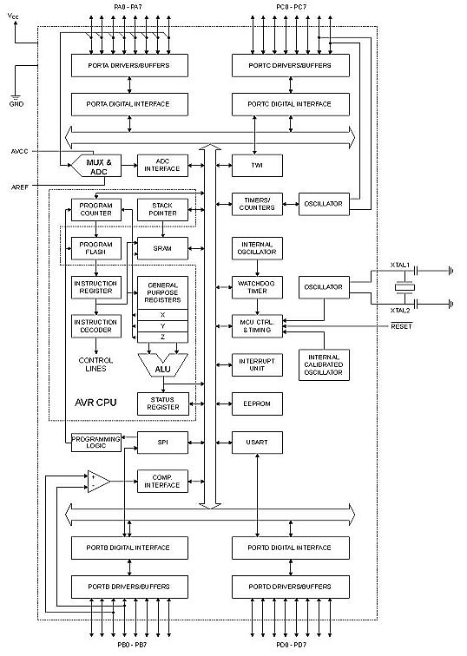
ATMega 8535 Architecture
4 I/O port (4x8) Port A, B, C and D
ADC (Analog to Digital Converter)
3 Timer/Counter
32 register
512 byte SRAM
8kb Flash memory
Internal and external interrupt
SPI interface port to download program into flash
512 byte EEPROM
Analog comparator interface
USART port for serial communication

Slide 5
Prerequisite for Programming a Microcontroller
Before you start to program a μC, you need to understand 2 things:
The Instruction Set of the μC
The hardware capability of the μC
Most μC comes with an IDE (Integrated Development Environment) to build and run your program
For Atmel μC, you may choose either Assembly or C for your programming language

Slide 6
Instruction Set
ATMega 32

Slide 7
What is Instruction Set?
Instruction is like a command to be executed by Control Unit within the μP
Instruction is usually grouped by 4 types:
Data transfer (ex. MOV)
Arithmetic and Logic (ex. ADD)
Control Transfer (ex. JMP)
Miscellaneous (ex. NOP)
Every μP has their own instruction
Instruction set is the list of instruction understood only by a specific μP

Slide 8
Basic Instruction (1/2)
LDI (Load Immediate): writes a constant into a register ex. LDI R16,0xFF (writes FF_{H} into register 16)
OUT: writes data from register to a specific I/O port ex. OUT DDRA,R16 (writes data from register 16 to port A)
IN: reads data from a specific I/O port into a register ex. IN R16, PORTA (reads data from port A and stores it to register 16)
SBI (Set bit in I/O): set (put into High Voltage) a bit in I/O port ex. SBI PORTA,0 (set bit 0 in port A to High Voltage)
CBI (Clear bit in I/O): unset (put into Low Voltage) a bit in I/O port ex. CBI PORTA,1 (set bit 1 in port A to Low Voltage)

Slide 9
Basic Instruction 2/2
SBIS (Skip if bit in I/O is set): skip 1 instruction below if a specific bit in I/O port is set (High Voltage) ex. SBIS PORTA,2 RJMP RPT “RJMP RPT” will be skipped if bit 2 in port A is High Voltage
SBIC (Skip if bit in I/O is cleared): skip 1 instruction below if a specific bit in I/O port is unset (Low Voltage) ex. SBIC PORTA,2 RJMP RPT “RJMP RPT” will be skipped if bit 2 in port A is Low Voltage

Slide 10
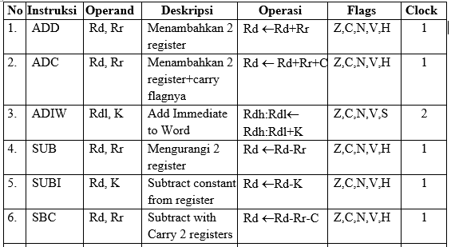
Arithmetic Instruction (1/4)

Slide 11
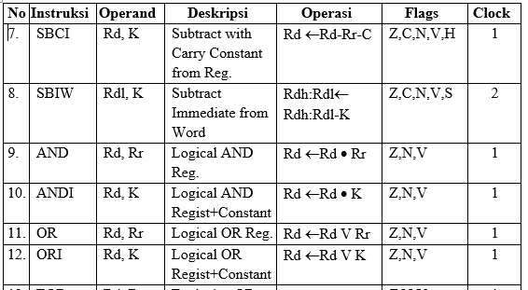
Arithmetic Instruction (2/4)

Slide 12
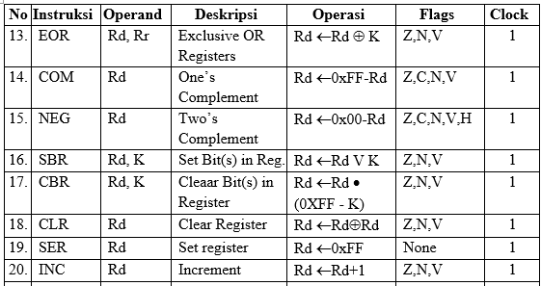
Arithmetic Instruction (3/4)

Slide 13
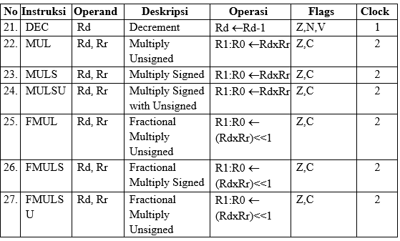
Arithmetic Instruction (4/4)

Slide 14
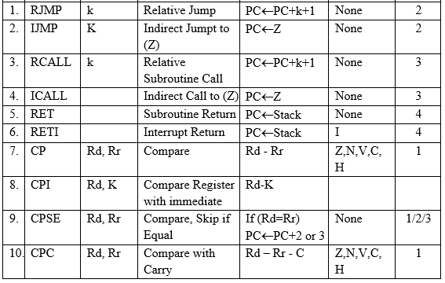
Branch Instruction (1/4)

Slide 15
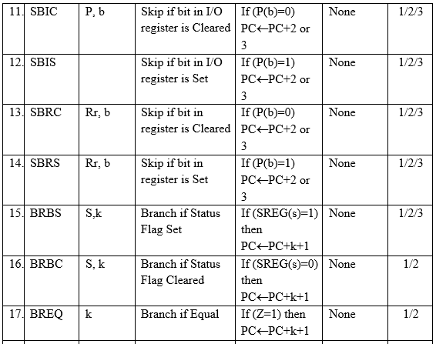
Branch Instruction (2/4)

Slide 16
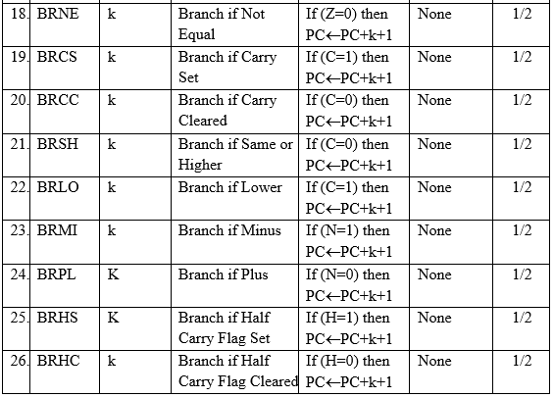
Branch Instruction (3/4)

Slide 17
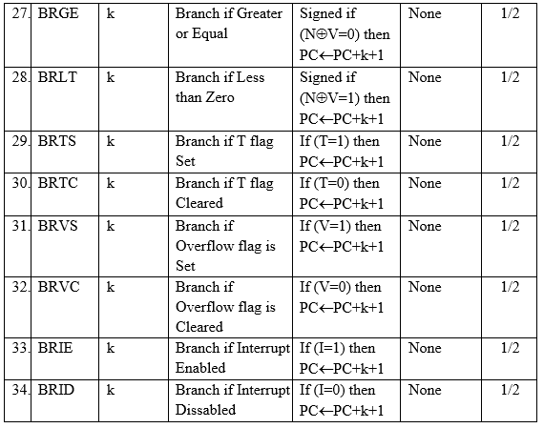
Branch Instruction (4/4)

Slide 18
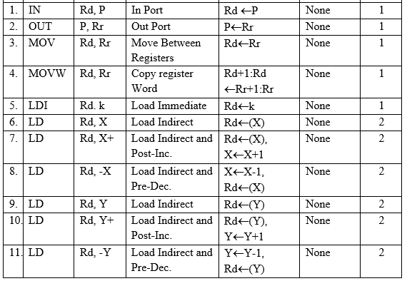
Data Transfer Instruction (1/4)

Slide 19
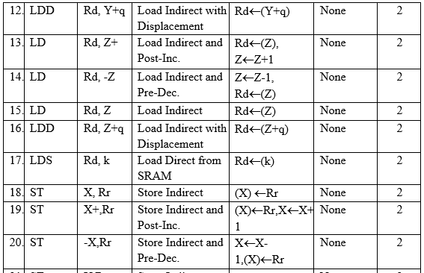
Data Transfer Instruction (2/4)

Slide 20
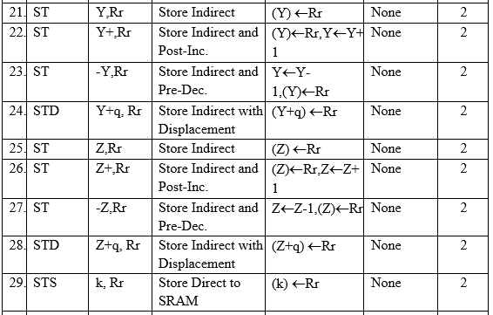
Data Transfer Instruction (3/4)

Slide 21
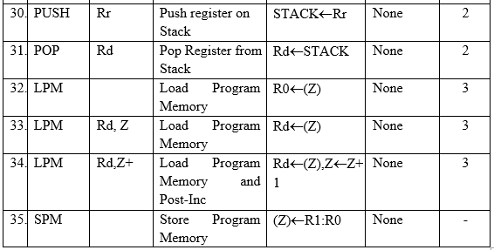
Data Transfer Instruction (4/4)

Slide 22
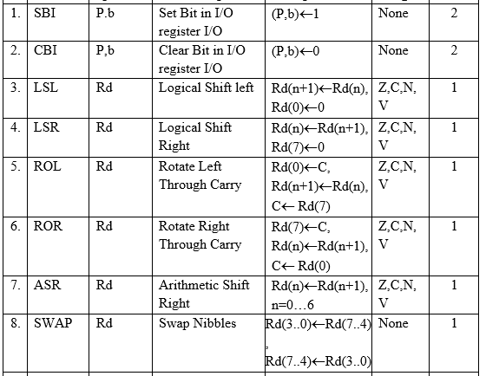
Bit Test Instruction

Slide 23
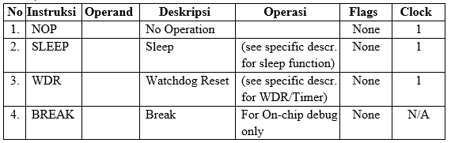
Control Instruction

Slide 24
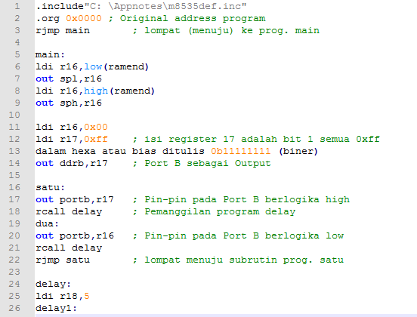
Assembly Example

Slide 25
Hardware Capability

Slide 26
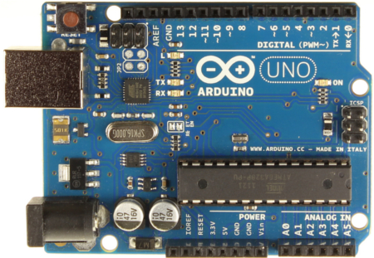
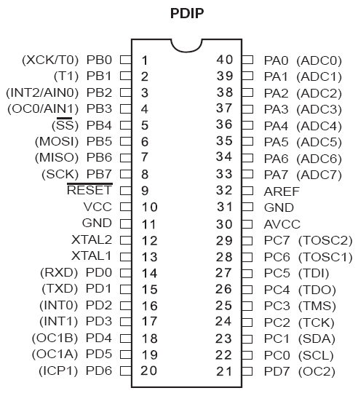
ATMega 32: Pin Layout
Port B
Port A
Port C
Port D

Slide 27
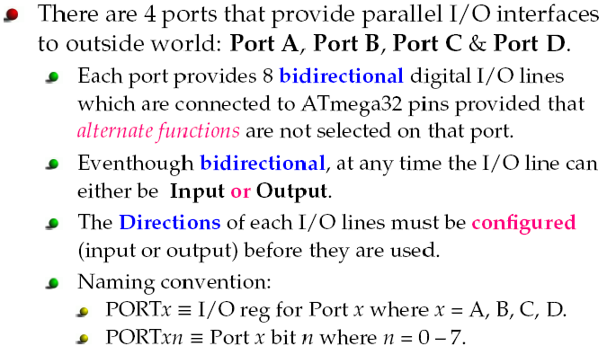
ATMega32 Pin out & Descriptions

Slide 28

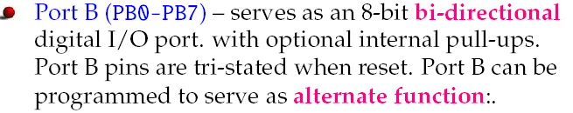
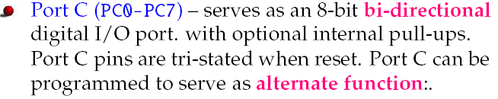
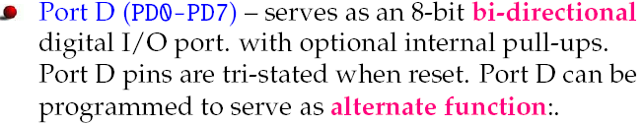
Port Description

Slide 29
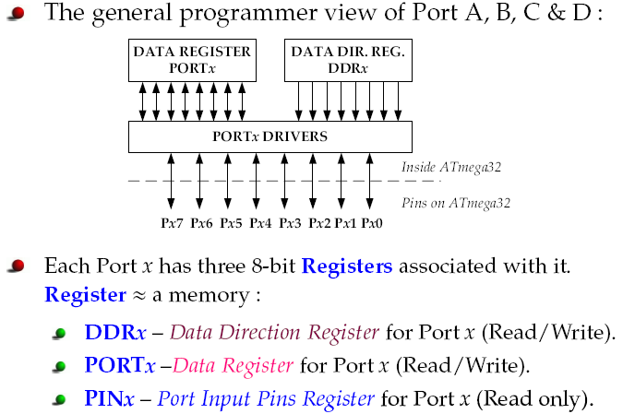
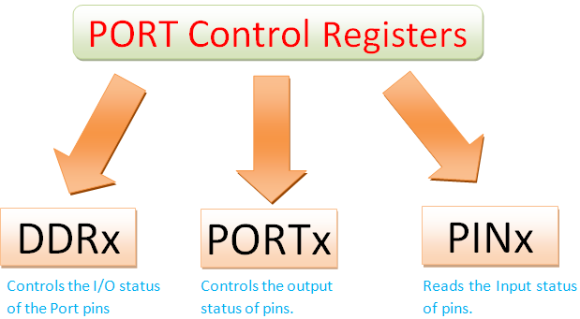
ATMega32 Pin out & Descriptions

Slide 30
Single pin accessing

Slide 31
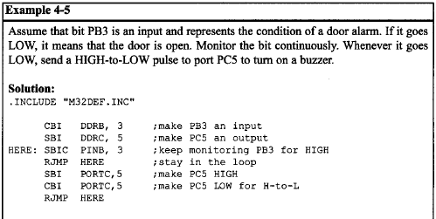
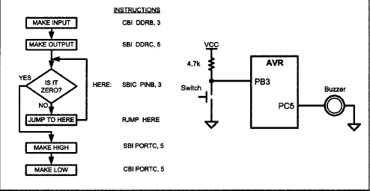
Example

Slide 32
Using C Language to Program your Microcontroller

Slide 33
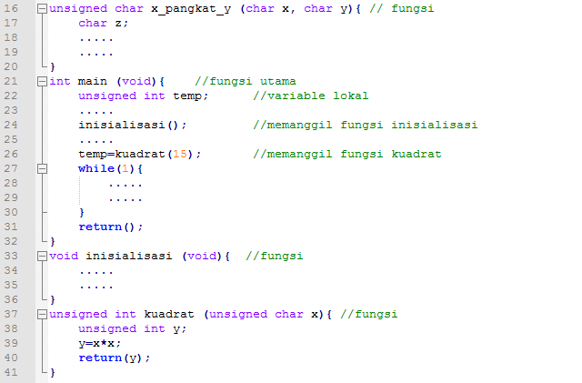
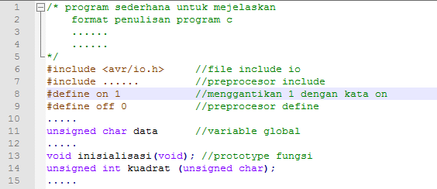
An Example of ATMEL Program in C Language

Slide 34
Comment
Ignored by compiler but very useful for other to understand the program
/* for writing comment in a paragraf */
// for writing a 1 line comment

Slide 35
Preprocessor (6-10)
Preprocessor #include can be used to attach a library function (h header file) so we may use many built in functions
Header “io.h” contains definition for SFR (Special Function Register) and all pins and bits in μC
Preprocessor #define is used for defining a constant or macro

Slide 36
Variable Declaration
Variable is used to store a value within a program
A global variable is defined outside any function and can be accessed by all functions
A local variable is defined inside a function and can only be accessed by that function
How to define variable:
DataType VariableName;

Slide 37
Function Prototype
Used to define a function to be called by other function (usually by main function)
How to define function:
DataType FunctionName (DataType Parameter1, DataType Parameter 2)

Slide 38
Main Function
The first function to be executed starting from the first line
How to call a function from main function:
Without return value and without input parameter function()
With return value but without input parameter variable = functionName();
With return value and with input parameter variable = functionName(variable_or constant)

Slide 39
Sub-Program or Function
Function is a sub module to solve a specific problem (ex. calculate factorial)
How to define a function:
Without return value and without input parameter void function(void)
With return value but without input parameter DataType functionName(void);
With return value and with input parameter DataType functionName(DataType parameter1, ...)

Slide 40
Data Type
Data Type | Byte | Bit | min | Max
char | 1 | 8 | -128 | 127
signed char | 1 | 8 | -128 | 127
unsigned char | 1 | 8 | 0 | 255
Int | 2 | 16 | -32768 | 32767
signed int | 2 | 16 | -32768 | 32767
unsigned int | 2 | 16 | 0 | 65535
long | 4 | 32 | -2147483648 | 2147483647
signed long | 4 | 32 | -2147483648 | 2147483647
unsigned long | 4 | 32 | 0 | 4294967295
float | 4 | 32 | 1,28E-38 | 3,4E38

Slide 41
ATMEL Studio
Please try to explore the ATMEL Studio using provided example projects

Slide 42
See you on next class

